Slide 1

Topic: Arabic tweets sentiment analysis
Presentation for NLP project
Supervised by: DR. Mervat Abuelkheir & ENG. Mayar Osama
Authors: Mohamed Hesham
Mariam Hesham
Mostafa Mohamed
Date: 8/5/2023

Slide 2
Outline
Introduction
Motivation
Methods (approaches)

Slide 3
01
Introduction

Slide 4
Introduction
Arabic is a widely spoken language with a rich cultural heritage, and sentiment analysis of Arabic text is a challenging task due to the complexity and nuances of the language.
Sentiment analysis is a subfield of natural language processing that involves using computational techniques to identify and extract subjective information from text

Slide 5
Motivation
Social media platforms have become an important medium for people to express their views and share information with others. Twitter, particularly, has become a powerful platform for people to express their opinions on a wide range of topics, from politics and current events to entertainment and personal experiences.

Slide 6
Limitations
Limited dataset size: The dataset used in this project consists of over 2600 Arabic tweets, which may not be representative of the diversity of opinions and attitudes in the Arab world.
Limited domain specificity: The dataset used in this project is not domain-specific, meaning it covers a wide range of topics and contexts.

Slide 7
Limitations
The dataset is somehow imbalanced as nearly 38% is labeled as positive, 32% is labeled negative and 28% is neutral.
Imbalanced datasets in sentiment analysis can be solved by: -Under-sampling
-Oversampling
-Class weighting

Slide 8
02
Methods

Slide 9
Methods
1-Dataset gathering and Preprocessing
2-Data Analysis
3- System Architecture

Slide 10
Dataset Gathering
The dataset used in this project is a publicly available collection of Arabic tweets that have been manually labeled for sentiment.
There are a total of over 2600 tweets in the dataset, with 2060 tweets used for training and 688 tweets used for testing.

Slide 11
Data Preprocessing
Tokenization: Tokenization is the process of splitting a sentence or text into individual words or tokens. We used the Arabic word tokenizer provided by the NLTK library to tokenize the tweets into words.
Stop-words removal: Stop-words are commonly used words in a language that do not carry any significant meaning. We used the Arabic stop-words list provided by the NLTK library to remove stop-words from the tokenized tweets.
Removing stop-words can help reduce the dataset’s size and remove noise from the text data.

Slide 12
Data Preprocessing
Removal of special characters and symbols: Special characters and symbols like "@", "*", and "\$" are commonly used in social media and can add noise to text data. We used regular expressions to remove these characters from the tweets.
Removing emojis: Emojis are commonly used in social media to convey emotions and sentiments. However, they can add noise to the text data, making it harder to analyze. We used regular expressions to remove emojis from the tweets.
Removing punctuation: Punctuation marks like commas, and periods can add noise to the text data. We used regular expressions to remove punctuation marks from the tweets.

Slide 13

Data analysis
The first approach: was to check the size of the total words in the dataset before and after the preprocessing steps to compare how cleaning the dataset affected its size.

Slide 14
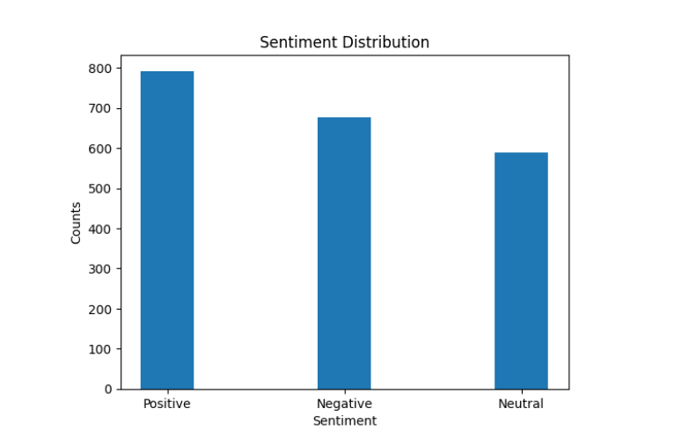
Data analysis
The second approach: was to examine the distribution of the dataset across the three sentiment categories, which are positive, negative, and neutral. This was achieved to assess any potential bias towards any particular sentiment class.

Slide 15
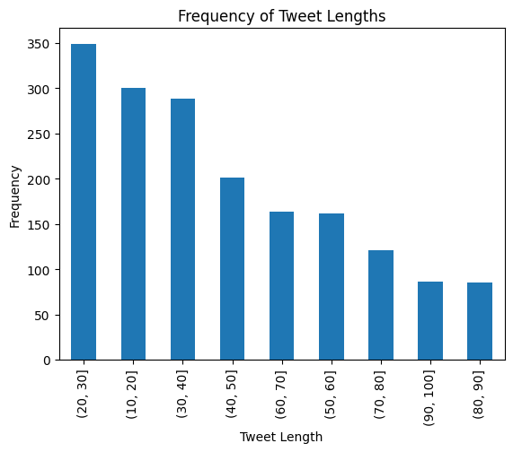
Data analysis
The third approach: aimed to investigate the tweet length distribution within the dataset to extract insights on the most frequent tweet lengths. To visualize the tweet length distribution, bar charts were utilized to plot the frequency of tweets for different length categories.

Slide 16
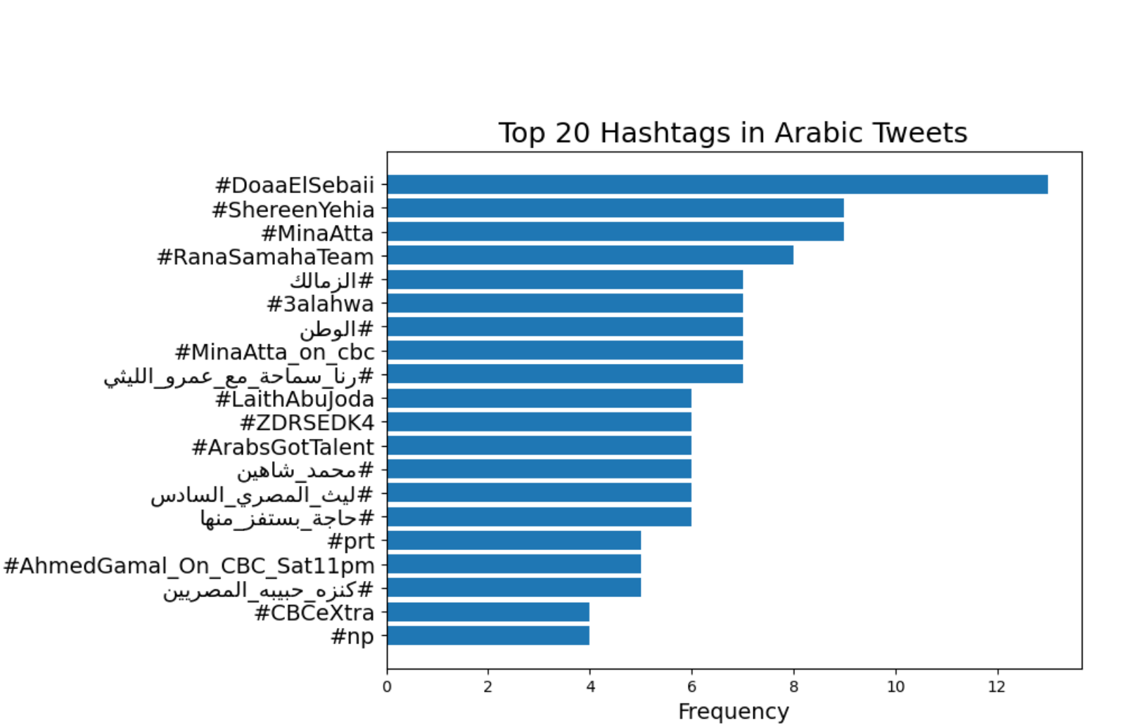
Data analysis
The fourth approach aimed to identify the most commonly used hashtags in the dataset, which could provide valuable insights into the main topics discussed in the tweets and thus the overall sentiment.

Slide 17
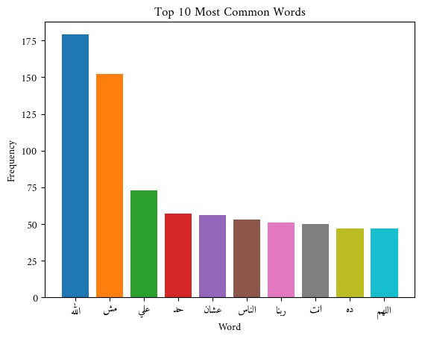
Data analysis
The final approach was to identify the most common 10 words used, this can provide insights into the topics or themes present in the dataset. By analyzing the most frequent words, we can gain a better understanding of the topics that people are talking about and the language that they use to express their sentiments.

Slide 18
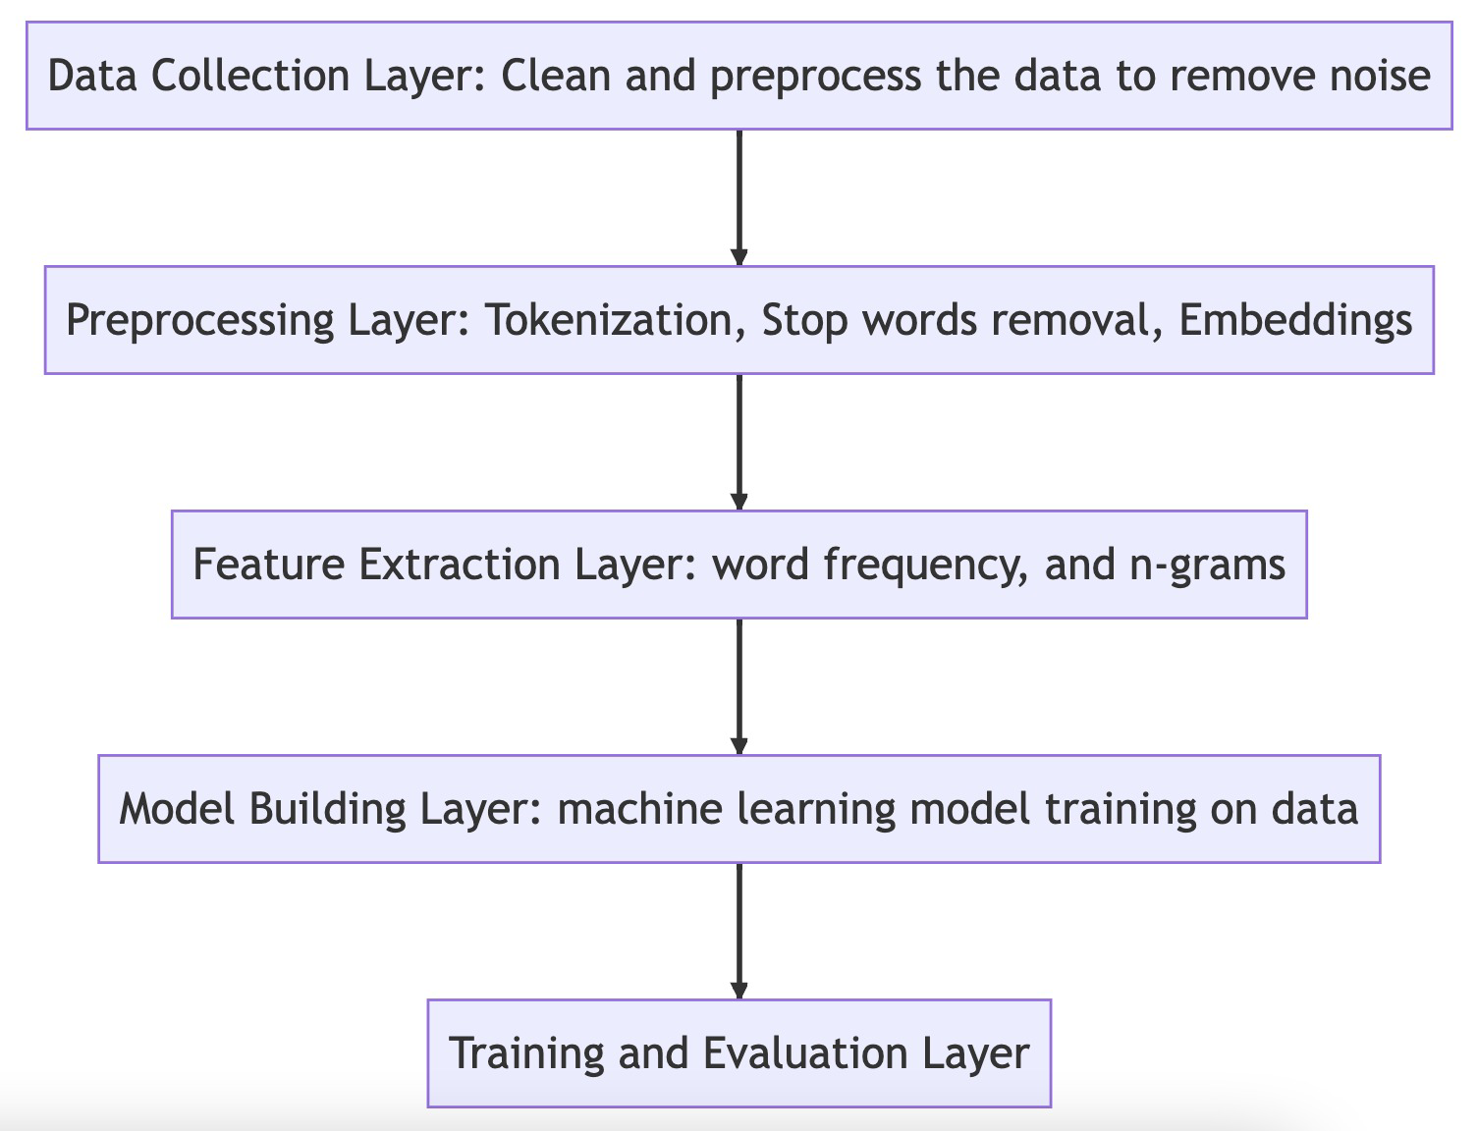
System Architecture

Slide 19
References
[1] Amr Al-Khatib and Samhaa El-Beltagy. Emotional tone detection in Arabic tweets. 04 2017.
[2] Omneya Rabie and Christian Sturm. Feel the heat: Emotion detection in Arabic social media content.In Industrial Conference on Data Mining, 2014.

Slide 20
Thank you
Questions?

